Slide 1
DAY 3
DAY 5
DAY 7
Legend
GO term
40
GO term
Log₂ fold-change
DAY 9
DAY 11
DAY 13

Slide 2
DEVELOPMENT

Slide 3
DAY 3
DAY 5
DAY 7
Legend
GO term
40
GO term
Log₂ fold-change
DAY 9
DAY 11
DAY 13

Slide 4
METABOLISM

Slide 5
DAY 3
DAY 5
DAY 7
Legend
GO term
40
GO term
Log₂ fold-change
DAY 9
DAY 11
DAY 13

Slide 6
TRANSPORT

Slide 7
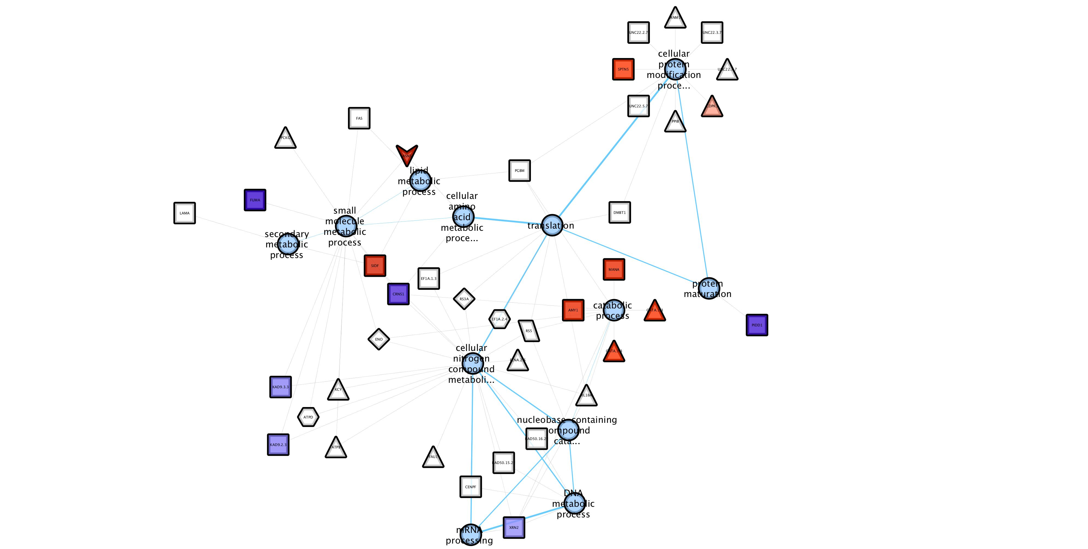
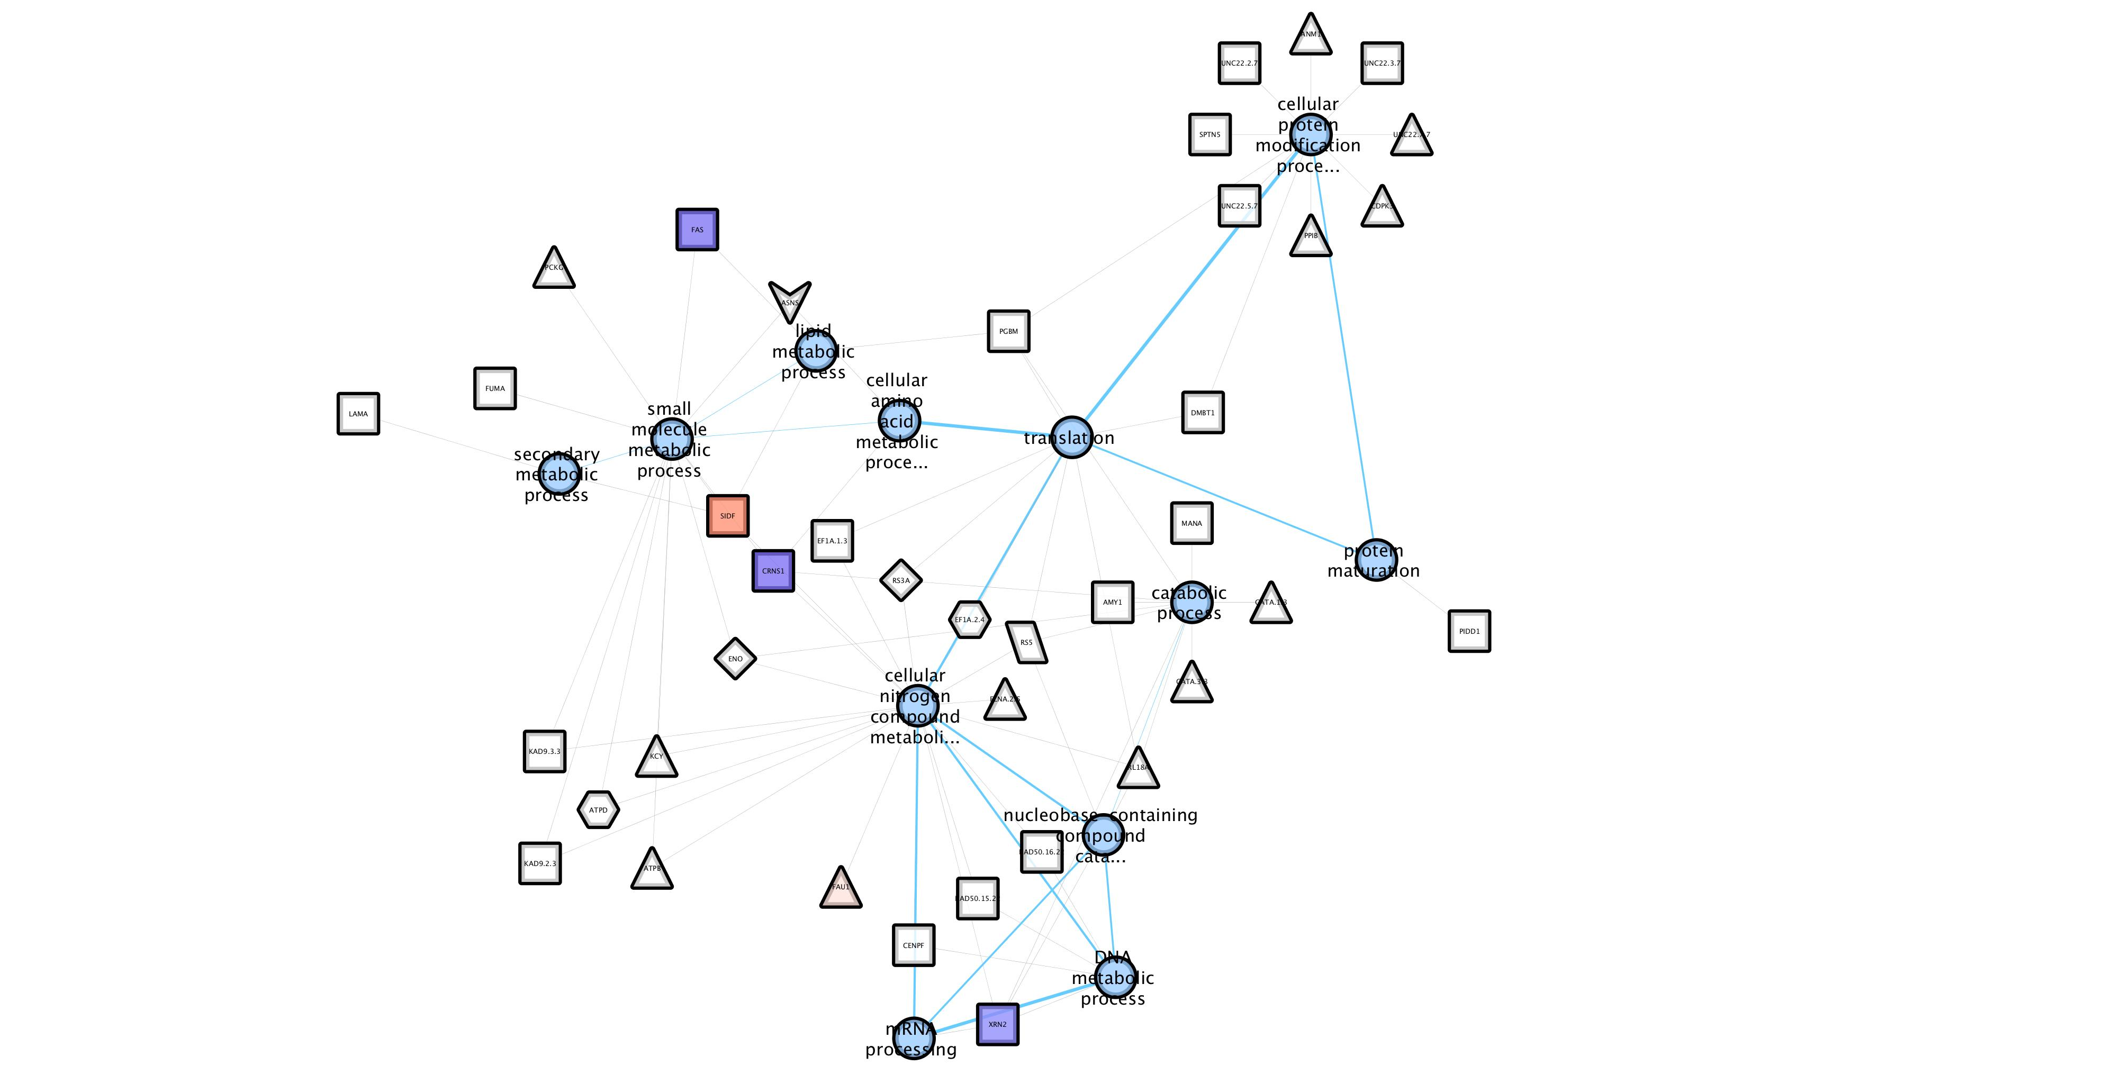
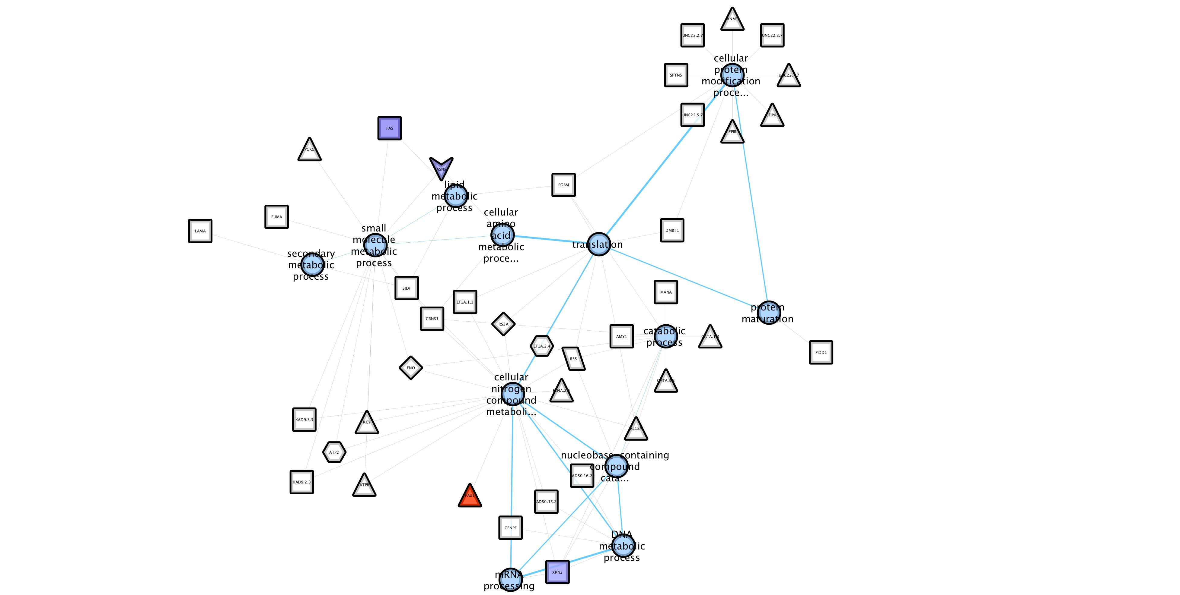
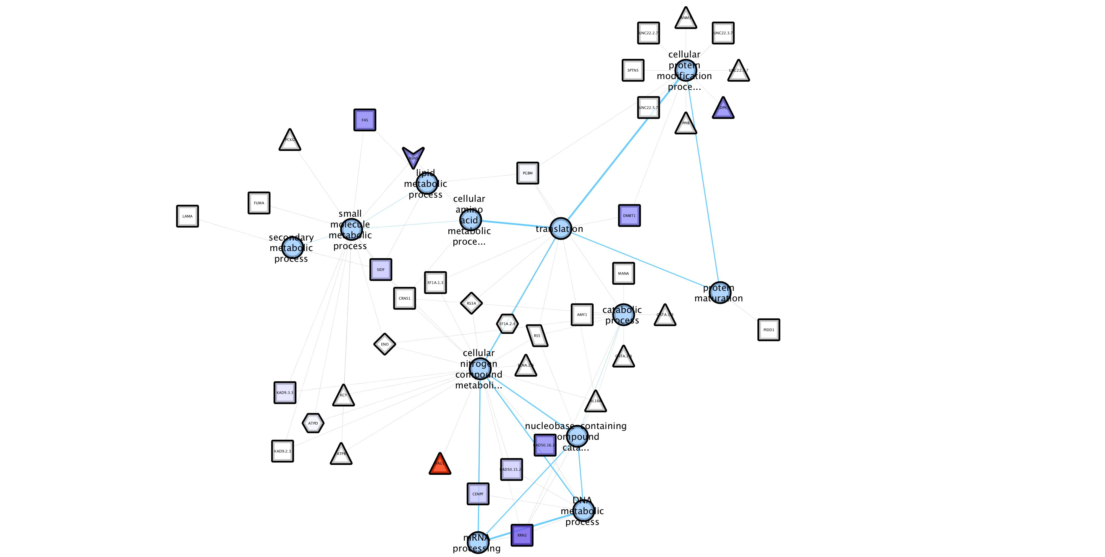
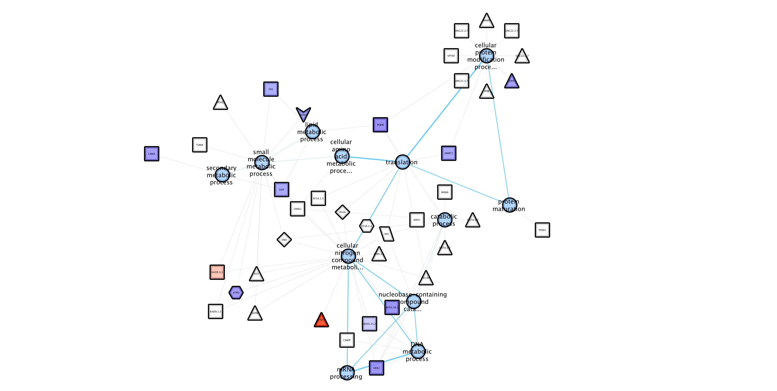
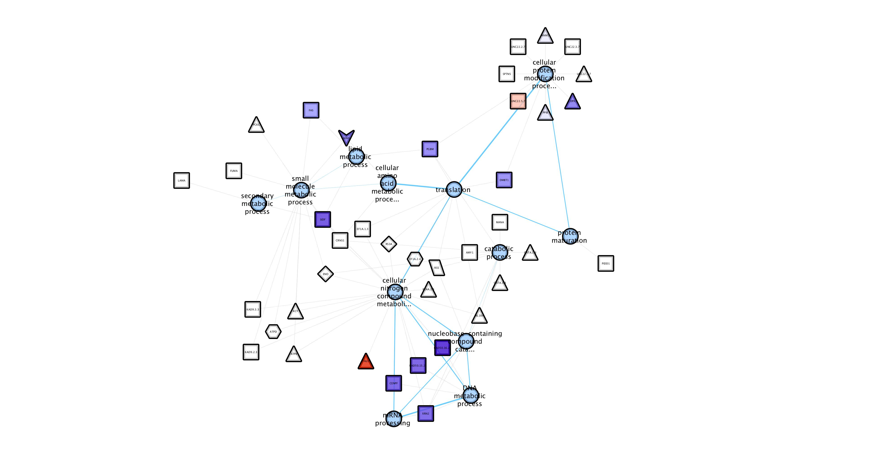
DAY 3
DAY 5
DAY 7
Legend
GO term
40
GO term
Log₂ fold-change
DAY 9
DAY 11
DAY 13

Slide 8
METABOLISM

